Slide 1
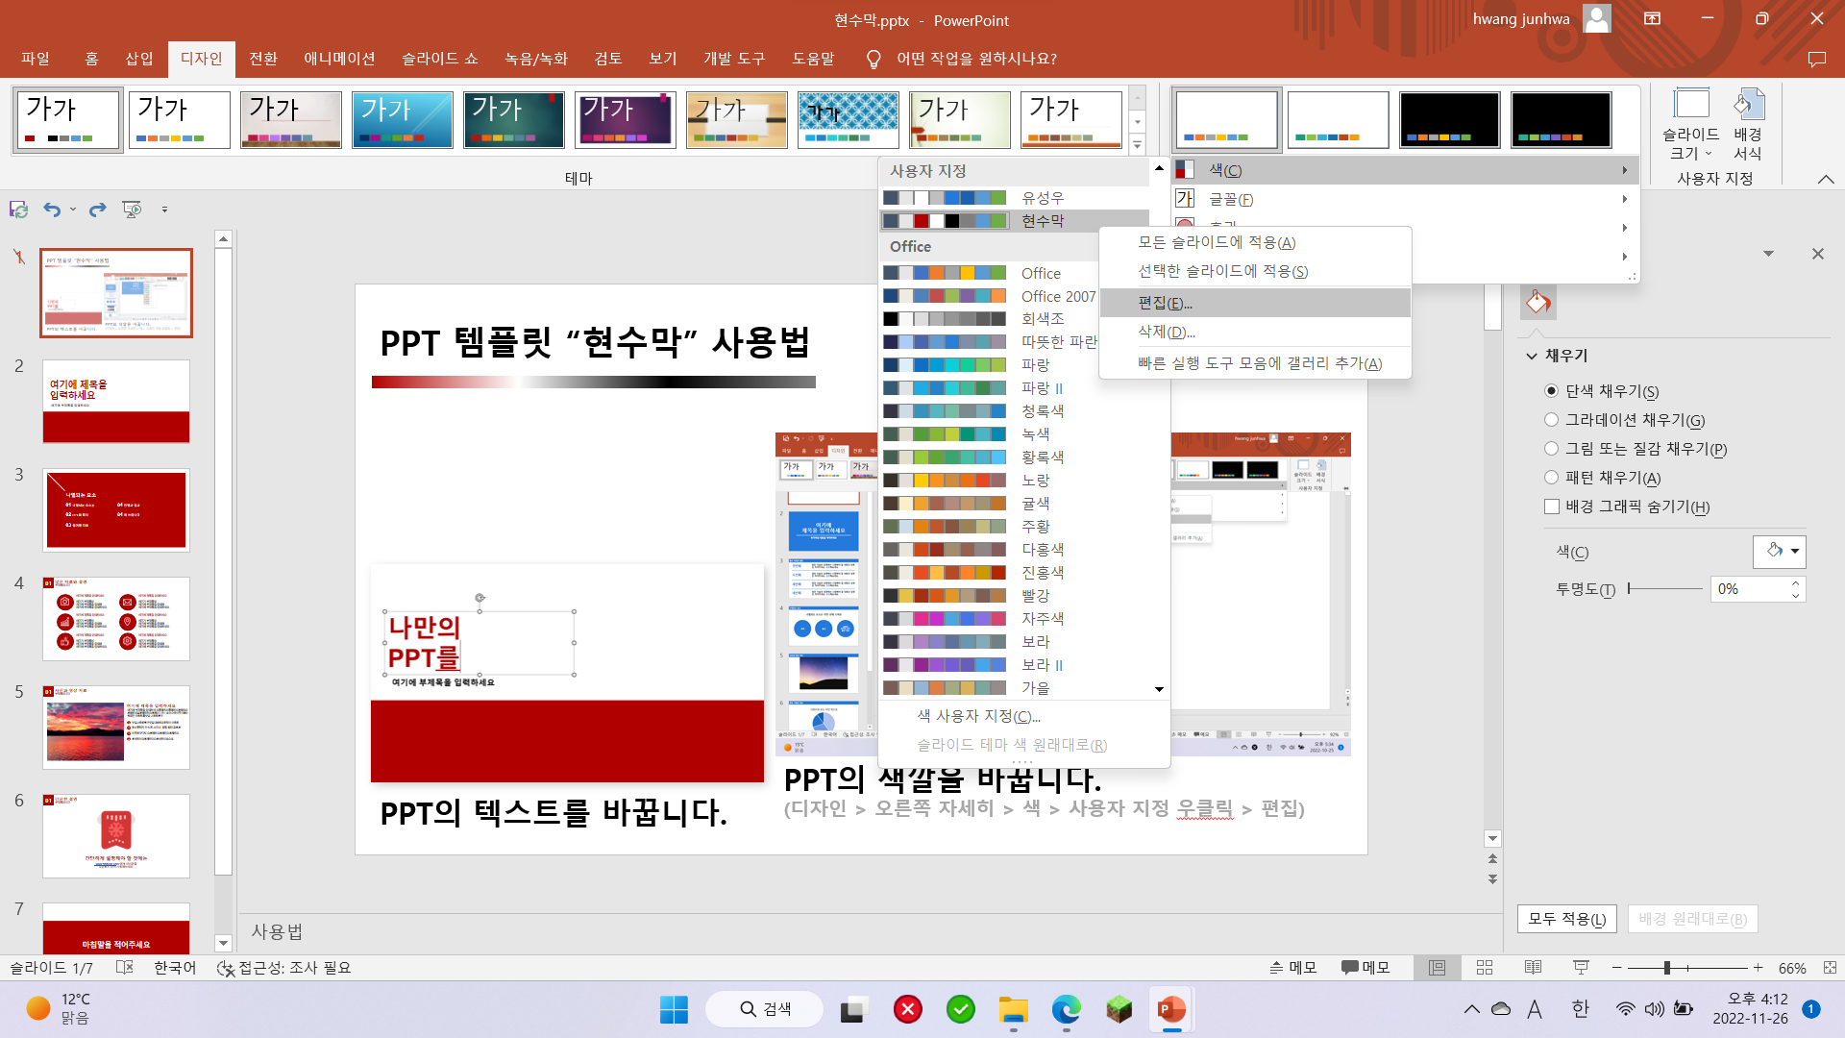
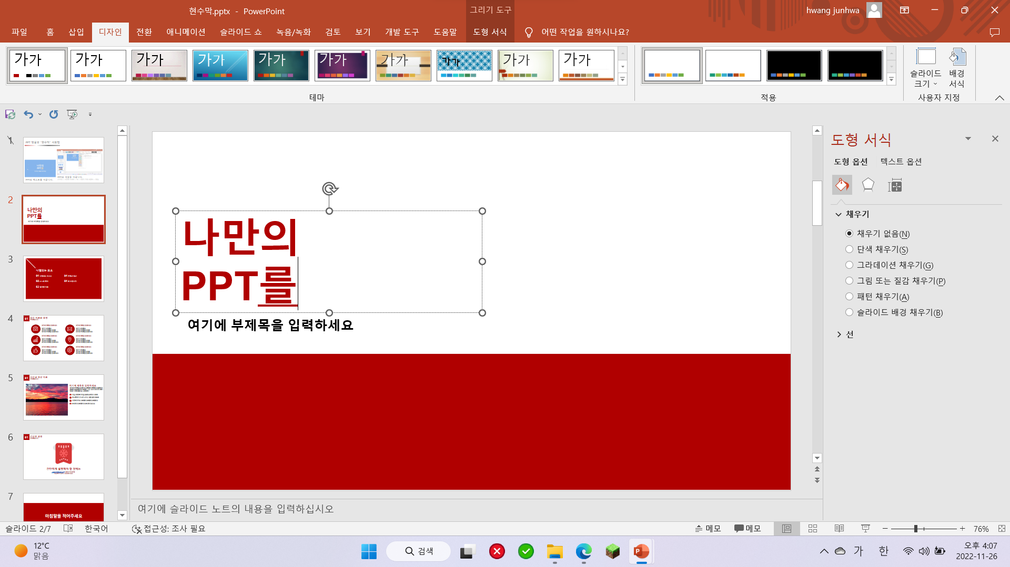
PPT 템플릿 “현수막” 사용법
PPT의 색깔을 바꿉니다.
(디자인 > 오른쪽 자세히 > 색 > 현수막 우클릭 > 편집)
PPT의 텍스트를 바꿉니다.
Notes:
사용법

Slide 2
Korean
Cuisine
황준화
Notes:
Hello my name is 황준화. I introduce Korean Cuisine

Slide 3
Index
01 Intro
04 KC’s hidden fact
02 Kimchi
05 Conclusion
03 Bibimbob
Notes:
Index, first Introduction, and Kimchi, Bibimbob, KC and Conclution

Slide 4

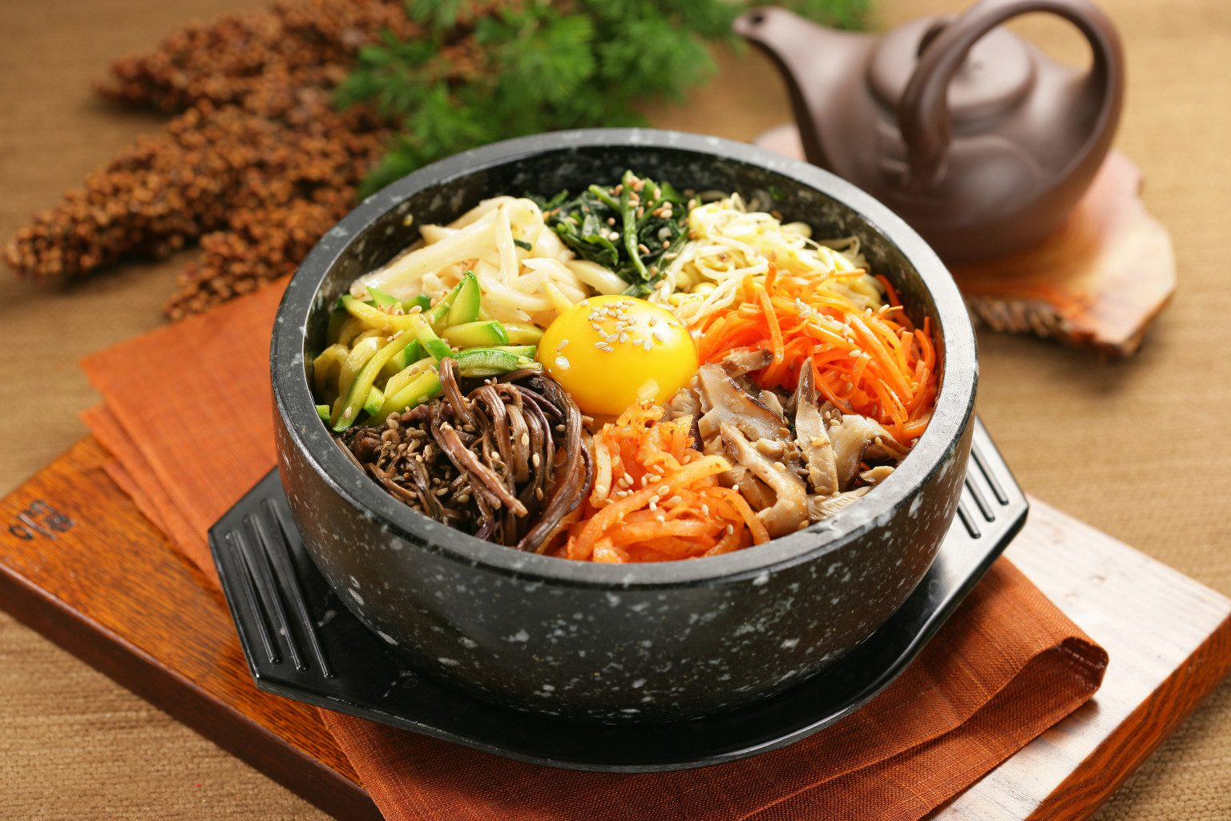

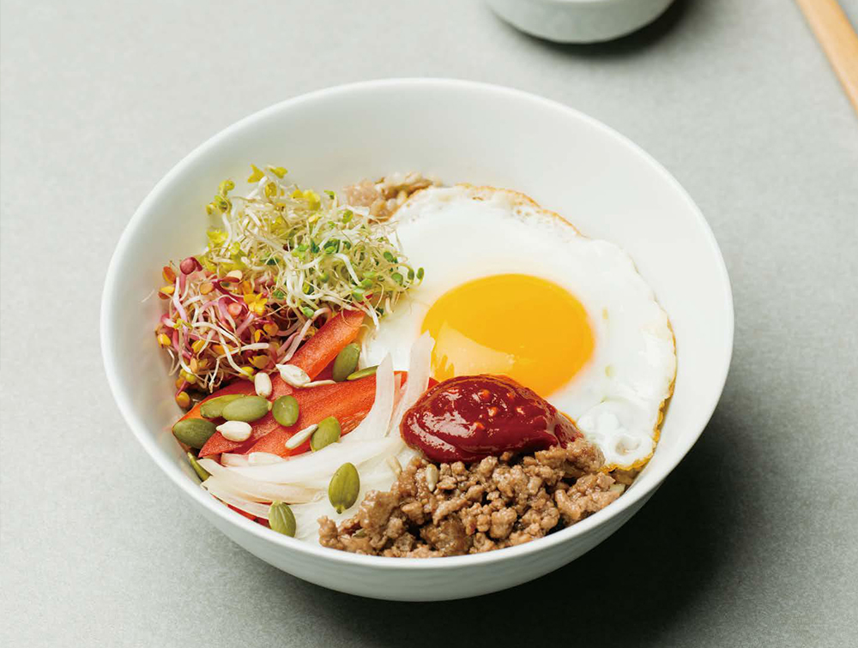
01
Introduction
What is Korea Cuisine?
Korea Cuisine
Korean Cuisine is also called Korean Food. It means traditional Korean dishes, and modernly recreated Korean food is also called "Fusion Korean food."
1
Where is Korean Cuisines, Kimchi?
2
Where is Bibimbob?
Notes:
Introduction, What is Korean Cuisine? 설명 읽고 문제 1 => 2

Slide 5

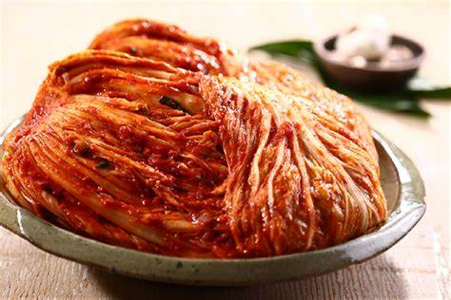
01
Kimchi
What is Kimchi
Kimchi is delicious
Koreans love Kimchi
Notes:
First, Kimchi Kimchi is delicious. They it Kimchi happily. Koreans love Kimchi

Slide 6
01
Kimchi
Graph to show people who loves Kimchi
Notes:
I asked my thousand of neurons it is result. 1% say never, 4% say no. 20% say not bad 34% say 34 and one thousand nine hundred 72 say very yes.

Slide 7
01
Kimchi
Nutritional Ingredients of Kimchi
Notes:
This is Kimchi’s nutritional ingredients. Navy is protein. Blue is Sodium. White is vitaminC. Ligth blue is other

Slide 8



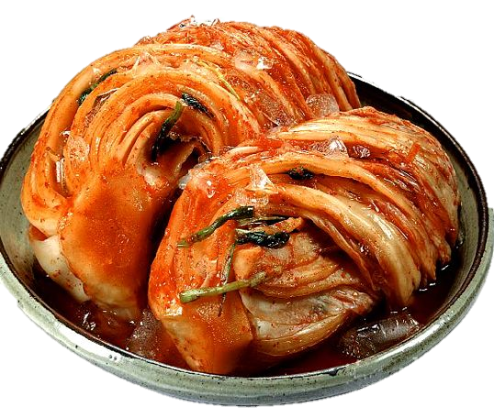
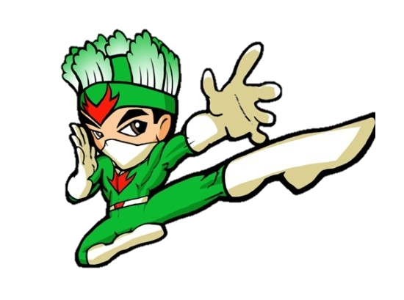
01
Kimchi
Kimchi’s Material
Chilly Pepper
Made from China
Spicy
Called by Pepper
Cabbage
Made from China
Sweet
Called by 백채(白菜)
Chilly Pepper
Made from China
Spicy
Called by Pepper
Cabbage
Made from China
Sweet
Called by 백채(白菜)
Notes:
Kimchi made from china cabbage and china’s chilly pepper

Slide 9

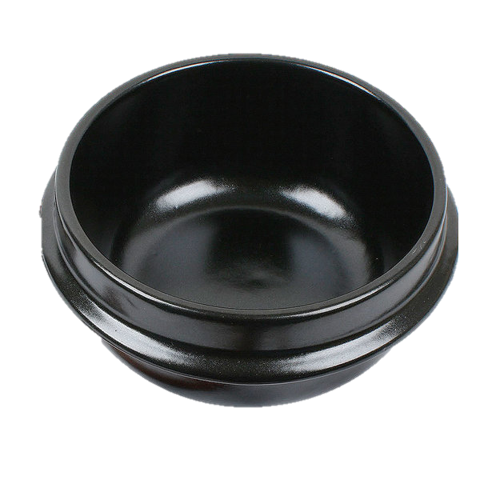
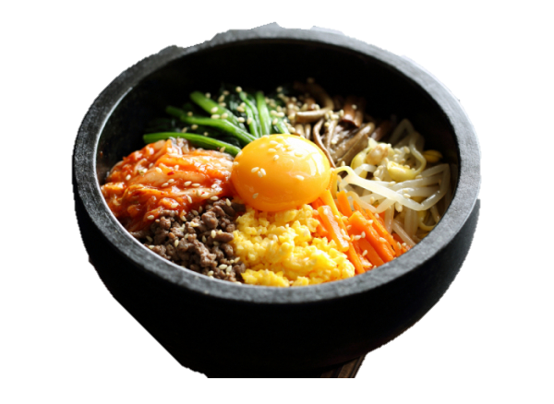
02
Bibimbob
Bear grils
Notes:
Bear grils love bibimbob Why?

Slide 10

02
Bibimbob
Bear grils’s very sad story: bibimbob save bear grils
Hidden video of Bear Grylls
Notes:
Bibimbob save bear grils from hunger. Watch vedio

Slide 11

03
KC’s hidden Fact
amazing
orean
uisines
Notes:
Do you know KC mark. It means Korean Cuisines.

Slide 12
Thank you for waching
Notes:
Thank you for Watching

